Slide 1

Artificial Neural Network Use Face Recognition as an Example
09015113 Qiaofeng Liu

Slide 2
Introduction
Artificial neural networks (ANNs) provide a general, practical method for learning real-valued, discrete-valued, and vector-valued functions from examples.
Algorithms such as BACKPROPAGATION use gradient descent to tune network parameters to best fit a training set of input-output pairs.
ANN learning is robust to errors in the training data and has been successfully applied to problems such as interpreting visual scenes, speech recognition, and learning robust control strategies

Slide 3
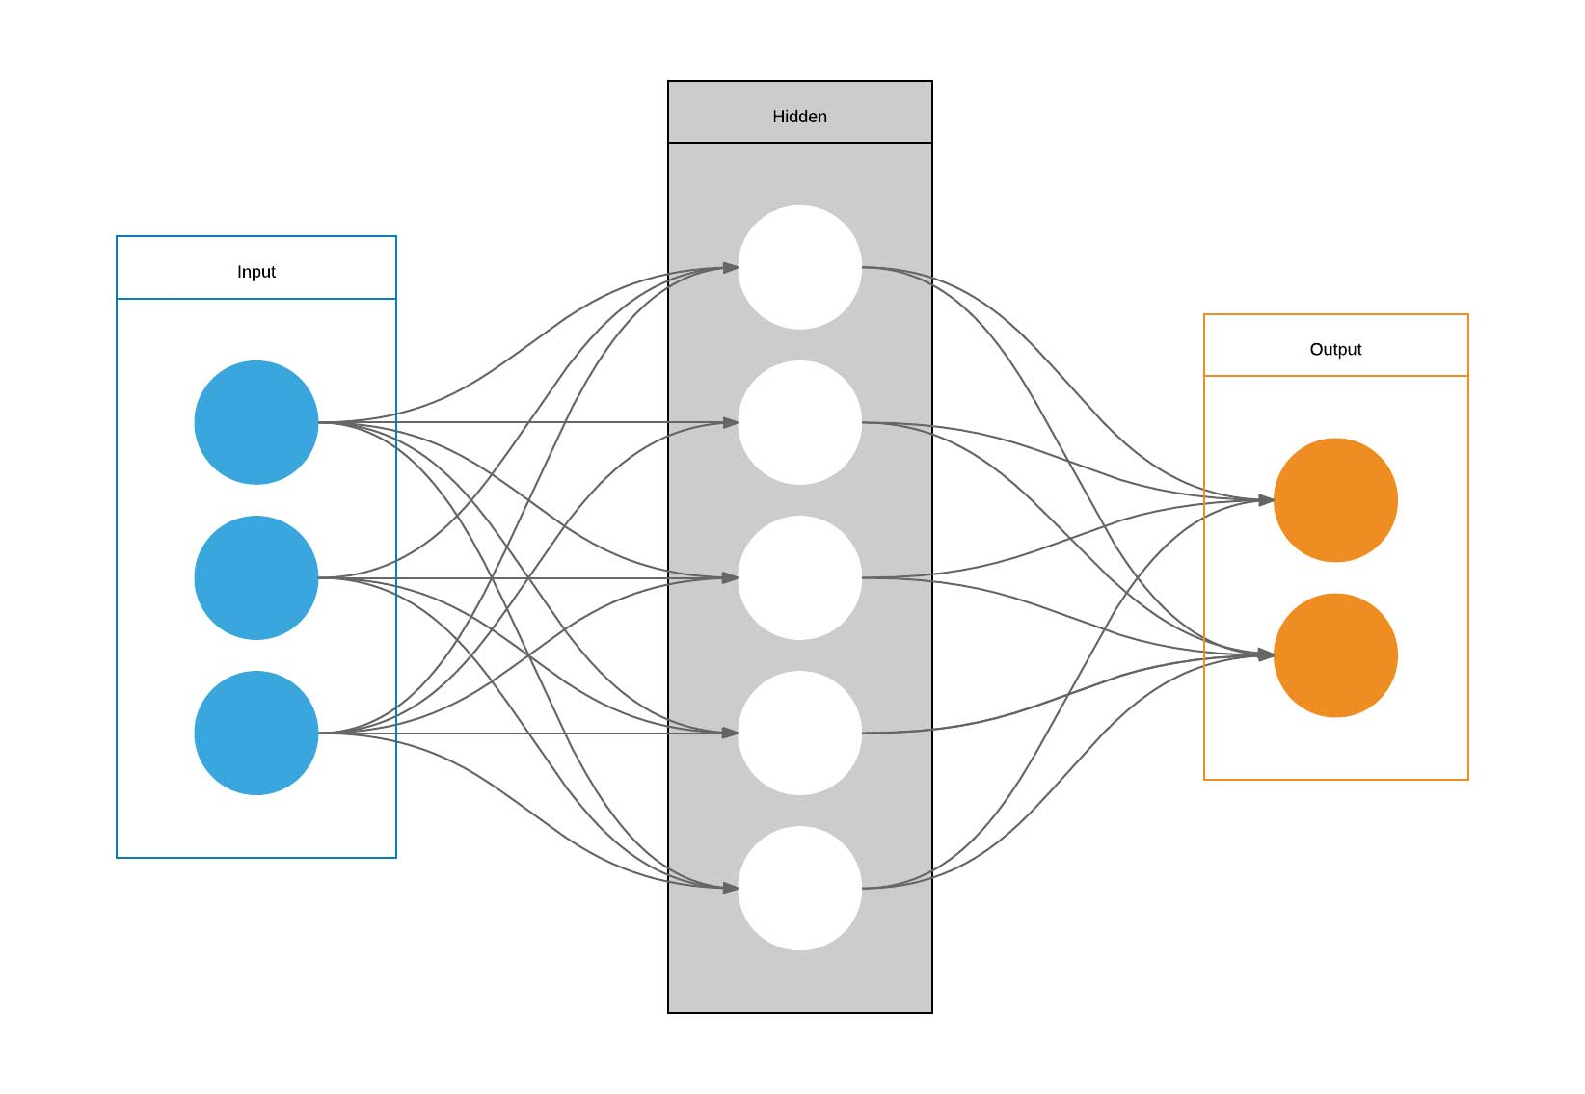
Example
Architecture:
1. Number of layers: 3
2. Number of hidden layer: 1
3. Fully Connected

Slide 4
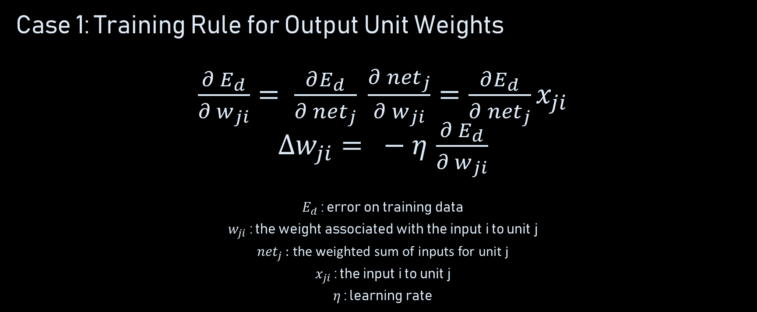
Backpropagation
Case 1: Training Rule for Output Unit Weights
$\frac{∂ E_{d}}{∂ w_{ji}}= \frac{∂E_{d}}{∂ {net}_{j}} \frac{∂ {net}_{j}}{∂ w_{ji}}=\frac{∂E_{d}}{∂ {net}_{j}}x_{ji}$
$∆w_{ji}= − η$ $\frac{∂ E_{d}}{∂ w_{ji}}$
$E_{d}$ : error on training data
$w_{ji}$ : the weight associated with the input i to unit j
${net}_{j }:$ the weighted sum of inputs for unit j
$x_{ji}$ : the input i to unit j
$η$ : learning rate

Slide 5

Backpropagation
Case 2: Training Rule for Hidden Unit Weights
$δ_{j}=$- $\frac{∂ E_{d}}{∂ {net}_{j}}=\frac{∂ o_{j}}{∂ {net}_{j}}\sum_{k ∈ Downstream(j)}{δ_{k} w_{kj}}$
$$∆w_{ji}= η δ_{j} x_{ji}$$
$o_{j}$ : the output computed by unit j
$Downstream(j)$ : the set of units whose immediate inputs include the output of unit j

Slide 6
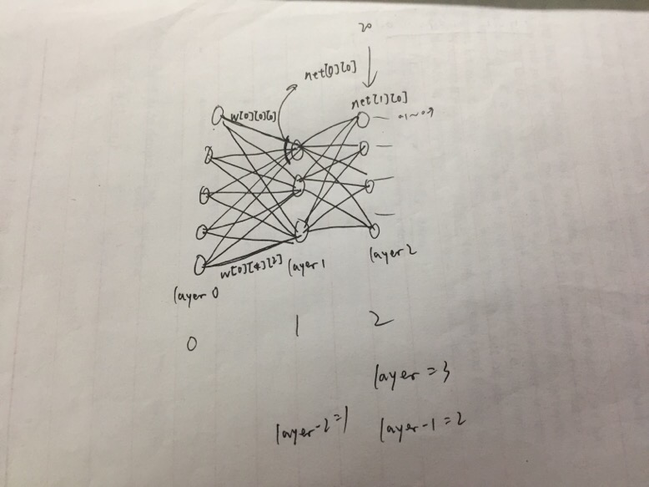
Engineering Details

Slide 7
Engineering Details
Talk is cheap, show me the code
Issues:
How can I maintain the precision of stored values?
How should the target value be labeled?
What architecture should it be?
What metric should I use to measure errors?
How can it speed up the training process?
How can the network improve its performance?

Slide 8
Real Case Test
OK, let’s test now!

Slide 9
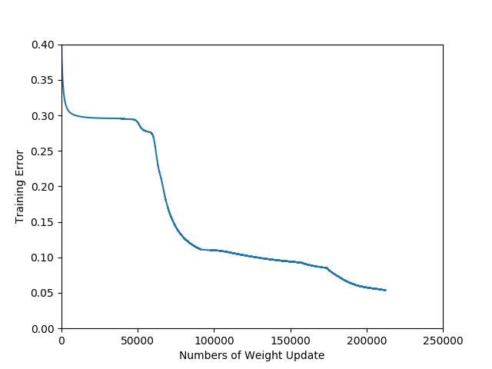
Statistical Analysis
分析：
1. 学习率不同
2. 设置动量增大，使得训练时能跳出局部
最优
3. 后期加入了正则化，使增长放缓

Slide 10
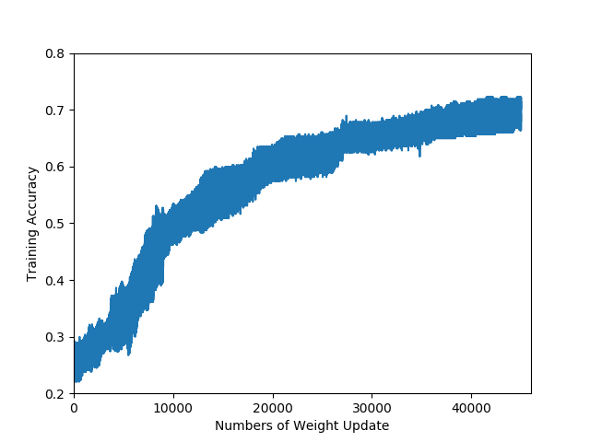
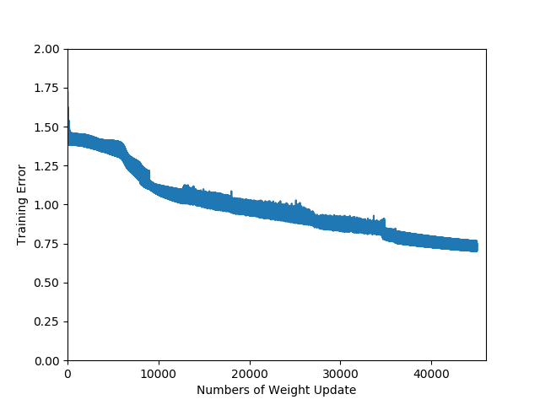
Statistical Analysis

Slide 11
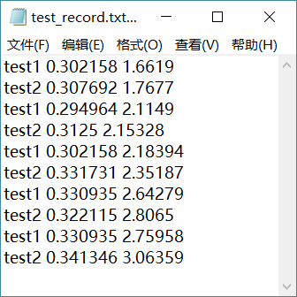
Statistical Analysis
分析：
1. 可能训练集和测试集数据分布不同
2. 选择的度量正确率/误差的方式不够好
3. 可能发生了过拟合
4. 没有做交叉检验

Slide 12
Discussion
Q: Something that can significantly influence the whole test
A: Many.
Q: Reflection on failure?
Q: Tools or Frameworks we can use?
A: MXNET, Tensorflow, PyTorch…
Q: State-of-the-art Algorithms (or Architecture)?
A: Convolution Neural Network!

Slide 13
Reference
Tom Mitchell’s book “Machine Learning”
Codes provided by Tom Mitchell
Stanford CS231n Online Lecture Notes : http://cs231n.github.io/
Matplotlib Tutorial: https://matplotlib.org/examples/index.html
Some other notes about Convolution Neural Network

Slide 14

Thanks for watching!

